Slide 1

Navigating The Modern Battlefront of JWT Security
Viktor Mares - Sr. Penetration Tester @SoCyber

Slide 2

ABOUT ME
Sr. Penetration Tester @SoCyber – Web Applications, APIs, Networks, Mobile Applications etc.
Writer on Medium.com with 1600+ followers and 80k+ reads
Speaker at OWASP Bulgaria Chapter (Dependency Confusion Attacks) & SoftUni Cyber Security Summit (Attacking Web Applications)
Certifications: eJPT, ICCA, eJPTv2, eWPT, eWPTXv2 & CAP
Bug Bounty Hunter: BugCrowd, Intigriti and private programs

Slide 3
Acronyms
JWT (JSON Web Token): JSON-based claims format using JOSE for protection
JOSE (JavaScript Object Signing and Encryption): set of open standards, including:
JWS (JSON Web Signature): JOSE standard for cryptographic authentication
JWE (JSON Web Encryption): JOSE standard for encryption
JWA (JSON Web Algorithms): cryptographic algorithms for use in JWS/JWE
JWK (JSON Web Keys): JSON-based format to represent JOSE keys

Slide 4
Table of Contents
1. Overview
2. Introduction to JSON Web Tokens
3. Deep Dive into JWT types (JWS, JWE, Nested) and JWKs
4. JOSE Algorithm Classes
5. Attack 1: Sign/Encrypt Confusion
6. JWS Serialization Types and Syntax
7. Attack 2: Polyglot Token
8. Deep Dive into Password-Based Authenticated Encryption (JWE w/ PBES2)
9. Attack 3: Billion Hashes Attack

Slide 5
Overview
We will have a closer look at JWTs and the JOSE standards and identify potential implementation mistakes that might result in vulnerabilities in JWT libraries if the RFCs are interpreted in certain ways.
We will look at three modern classes of JWT attacks that affected very widely used libraries (Authlib, JWCrypto & JWX):
Sign/Encrypt Confusion – auth bypass & token forgery
Polyglot Token – auth bypass & token forgery
Billion Hashes - can be leveraged for a denial-of-service attack against token-processing servers

Slide 6
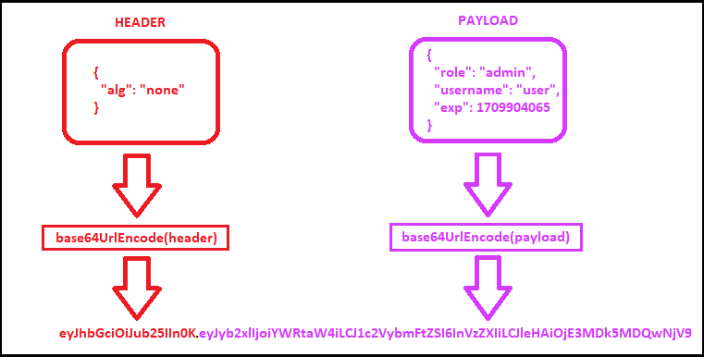
Example JSON Web Token (JWT)
To support use cases in which the JWT content is secured by a means other than a signature and/or encryption contained within the JWT (such as a signature on a data structure containing the JWT), JWTs MAY also be created without a signature or encryption.

Slide 7
JOSE Header
The following example JOSE Header declares that the encoded object is an Unsecured JWT:
{
“alg": “none“
}
An Unsecured JWT is a JWS using the "alg" Header Parameter value "none" and with the empty string for its JWS Signature value, as defined in the JWA specification.

Slide 8
JWT Payload
The payload contains statements about the entity (typically, the user) and additional entity attributes, which are called claims. In this example, our entity is a user.
{
"role": "admin",
"username": "user",
"exp": 1709904065
}

Slide 9
JWT Claims
JSON web tokens (JWTs) claims are pieces of information asserted about a subject. Claims are statements about an entity (typically, the user) and additional data.
For example, an ID token (which is always a JWT) can contain a claim called name that asserts that the name of the user authenticating is “user". In a JWT, a claim appears as a name/value pair where the name is always a string and the value can be any JSON value.
{
“admin": “true",
“name": "user",
"exp": 1709904065
}

Slide 10
JSON Web Tokens (JWT)
Defined by RFC7519:
JSON Web Token (JWT) is a compact, URL-safe means of representing
claims to be transferred between two parties. The claims in a JWT
are encoded as a JSON object that is used as the payload of a JSON
Web Signature (JWS) structure or as the plaintext of a JSON Web
Encryption (JWE) structure, enabling the claims to be digitally
signed or integrity protected with a Message Authentication Code
(MAC) and/or encrypted.

Slide 11
JSON Web Token Types
JWT is primarily of the following two types:
JSON Web Signature (JWS) – The content of this type of JWT is digitally signed to ensure that the contents of the JWT are not tampered in transit between the sender and the receiver. The content or claims of the JWS might be readable by other parties as well. Hence, a JWS can be used to verify the integrity of the content or claim but it should not be used to transfer sensitive data like passwords. JWS is typically used over HTTPS or SSL because it does not inherently prevent the data from being read.
JSON Web Encryption (JWE) – The content of this type of JWT is digitally encrypted. This means it can be used to verify the integrity and protect the content. It can be used over plain HTTP as it is inherently encrypting the content.

Slide 12
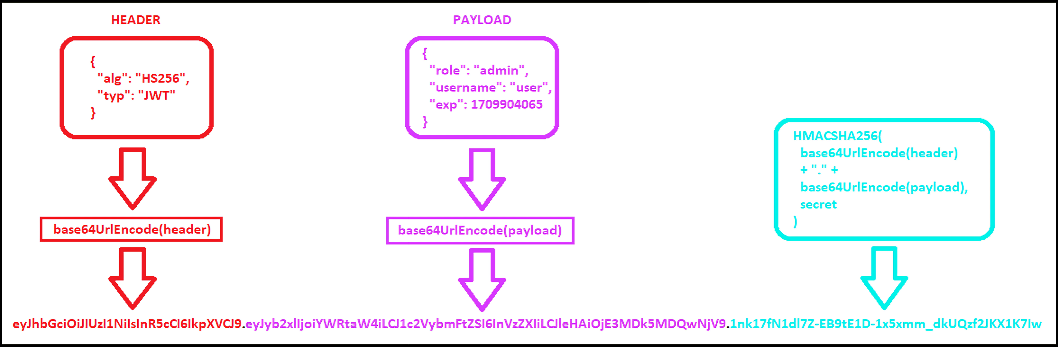
JWT in JWS Format

Slide 13
JOSE Header
JSON object containing the parameters describing the cryptographic operations and parameters employed. The JOSE (JSON Object Signing and Encryption) Header is comprised of a set of Header Parameters that typically consist of a name/value pair: the hashing algorithm being used (e.g., HMAC SHA256 or RSA) and the type of the JWT.
{
“alg": “HS256",
“typ": “JWT"
}

Slide 14
JWS Payload
JSON web tokens (JWTs) claims are pieces of information asserted about a subject.
The payload contains statements about the entity (typically, the user) and additional entity attributes, which are called claims. In this example, our entity is a user.
{
"role": "admin",
"username": "user",
"exp": 1709904065
}

Slide 15
JWS Signature
The signature is used to verify that the sender of the JWT is who it says it is and to ensure that the message wasn't changed along the way.
To create the signature, the Base64-encoded header and payload are taken, along with a secret, and signed with the algorithm specified in the header.
For example, if you are creating a signature for a token using the HMAC SHA256 algorithm, you would do the following:
HMACSHA256(
base64UrlEncode(header) + "." +
base64UrlEncode(payload),
secret
)

Slide 16
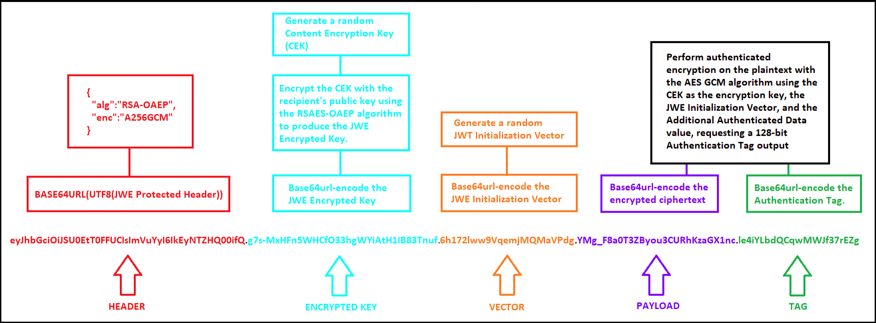
JWT in JWE Format

Slide 17
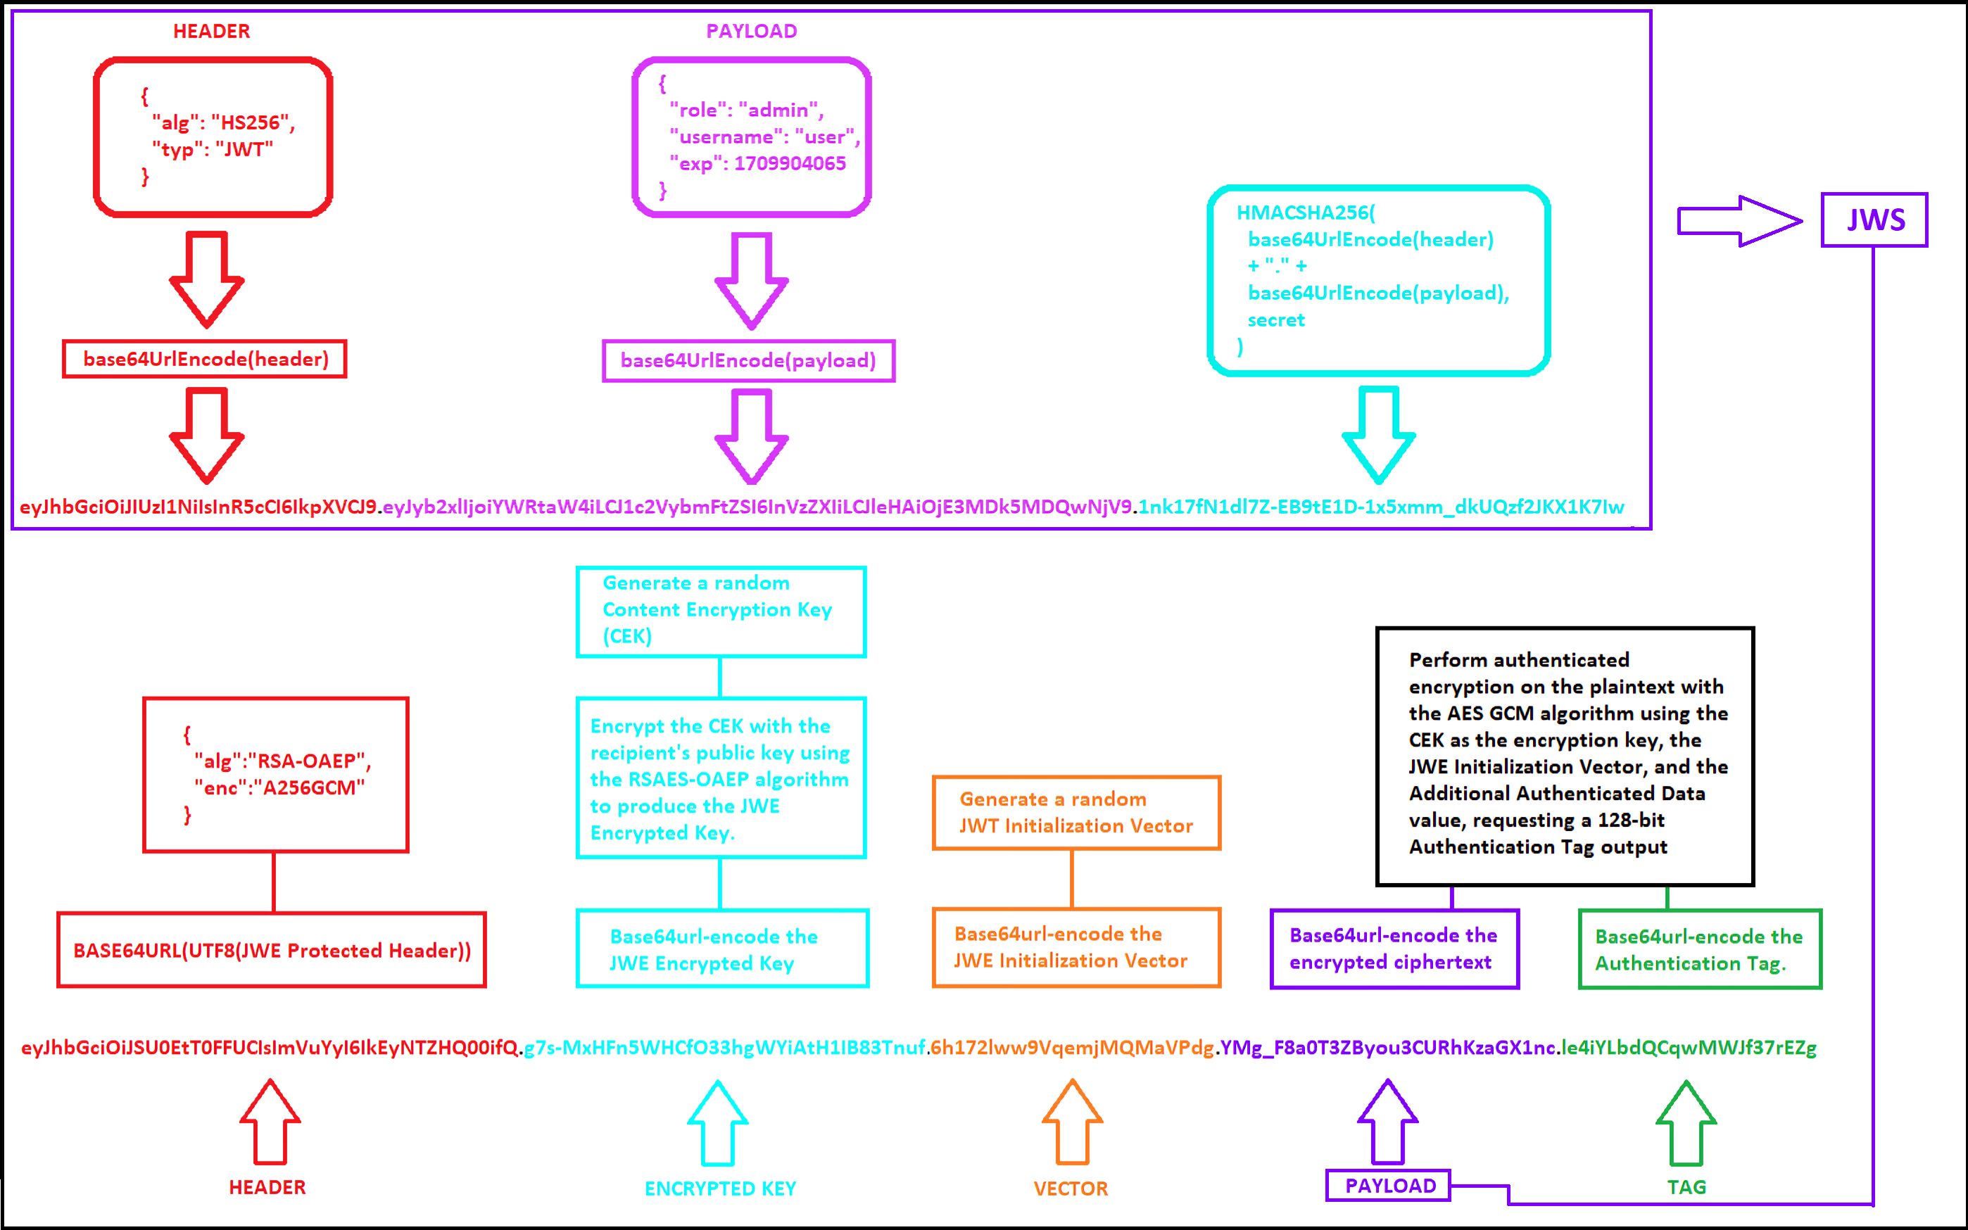
Nested JWT (JWS in JWE)
JSON Web Tokens can be signed (JWS) then encrypted (JWE) to provide confidentiality of the claims.
While it's technically possible to perform the operations in any order to create a nested JWT, senders should: 1. Sign the JWT
2. Encrypt the result

Slide 18
JSON Web Key Sets
The JSON Web Key Set (JWKS) is a set of keys containing the public keys used to verify any JSON Web Token (JWT) issued by the Authorization Server and signed using the RS256 signing algorithm.
When creating applications and APIs in Auth0, two algorithms are supported for signing JWTs: RS256 and HS256. RS256 generates an asymmetric signature, which means a private key must be used to sign the JWT and a different public key must be used to verify the signature.
Item | Description
JSON Web Key (JWK) | A JSON object that represents a cryptographic key. The members of the object represent properties of the key, including its value.
JSON Web Key Set (JWKS) | A JSON object that represents a set of JWKs. The JSON object MUST have a keys member, which is an array of JWKs.

Slide 19
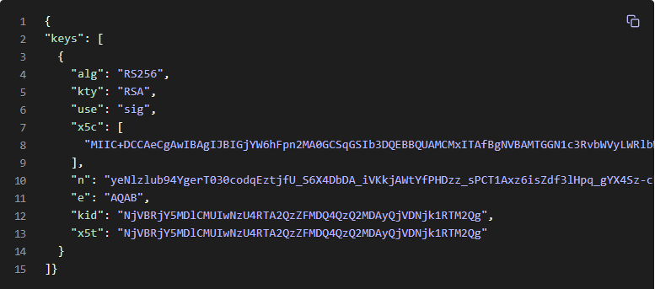
Locate JSON Web Key Sets
Use the Discovery endpoint to configure your application to automatically locate the JSON Web Key Set (JWKS) endpoint (jwks_uri), which contains the JWKS used to sign all Auth0-issued JSON Web Tokens (JWTs) signed with the RS256 signing algorithm.
Source: https://auth0.com/docs/secure/tokens/json-web-tokens/locate-json-web-key-sets

Slide 20
JSON Web Key Set Properties
Property Name | Description
alg | The specific cryptographic algorithm used with the key.
kty | The family of cryptographic algorithms used with the key.
use | How the key was meant to be used; sig represents the signature.
x5c | The x.509 certificate chain. The first entry in the array is the certificate to use for token verification; the other certificates can be used to verify this first certificate.
n | The modulus for the RSA Public Key
e | The exponent for the RSA Public Key
kid | The unique identifier for the key.

Slide 21
Attack 1:
Sign/Encrypt Confusion

Slide 22
Available JOSE algorithm classes
JOSE provides three distinct classes of cryptographic algorithms to cater for the four security objectives, with partially overlapping properties:
HMAC algorithms: A special super efficient hash (HMAC) for ensuring the integrity and authenticity of data. In order to compute an HMAC you need a secret key.
Digital signatures: Offer the properties of HMAC, plus cryptographic non-repudiation (enabling others than the signer to check the signature's validity). Digital signatures are based on public / private key cryptography. Require a public / private key pair (of type RSA, elliptic curve (EC), or Edwards-curve Octet Key Pair (OKP)).
Authenticated encryption: Encrypt data, while also ensuring its integrity and authenticity (like HMAC). JOSE offers encryption with public / private keys, with secret (shared) keys and with passwords.

Slide 23
Available JOSE algorithm classes
Integrity Objective: Verify data has not been tampered with
Authenticity Objective: The origin of the data can be verified
Confidentiality Objective: Data is kept secret from unauthorized parties and processes
Non-repudiation Objective: The origin of the data must be verifiable by others
 | Integrity | Authenticity | Non-repudiation | Confidentiality
HMAC | ✓ | ✓
Digital signatures | ✓ | ✓ | ✓
Authenticated encryption | ✓ | ✓ |  | ✓

Slide 24
Attack 1: Sign/Encrypt Confusion
Digital signatures work only with public / private keys:
The issuer needs to generate a public / private key pair before it can sign JWTs or other objects.
The signature is computed with the private key, which must be kept secure at all times, otherwise there is risk of impersonation.
The signature of a JWT or JWS object is validated with the public key.
 | Integrity | Authenticity | Non-repudiation | Confidentiality
Digital signatures | ✓ | ✓ | ✓

Slide 25
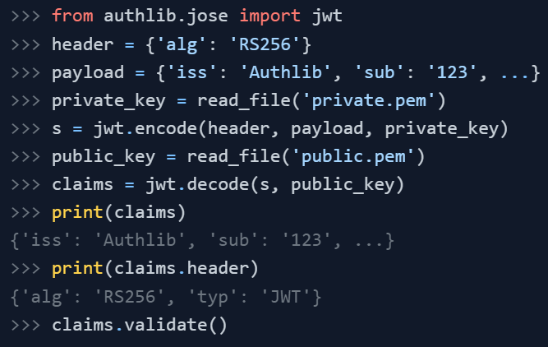
Attack 1: Sign/Encrypt Confusion
Authlib Example:
The imported jwt is an instance of JsonWebToken. It has all supported JWS algorithms, and it can handle JWK automatically. When we JsonWebToken.encode() a payload, JWT will check payload claims for security, if you really want to expose them, you can always turn it off via check=False.
Source: https://docs.authlib.org/en/latest/jose/jwt.html

Slide 26
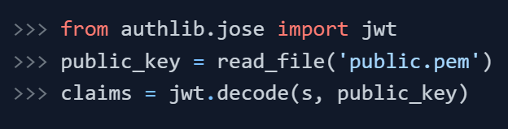
Attack 1: Sign/Encrypt Confusion
jwt.decode is the method to translate a JSON Web Token string into the dict of the payload:
This decoding method is insecure. By default jwt.decode parses the alg header. This allows symmetric macs and asymmetric signatures. If both are allowed a signature bypass is possible.
Source: https://docs.authlib.org/en/latest/jose/jwt.html

Slide 27
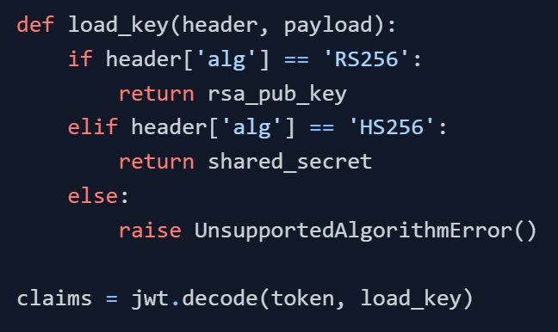
Attack 1: Sign/Encrypt Confusion
You should never combine symmetric (HS) and asymmetric (RS, ES, PS) signature schemes. When both are allowed a signature bypass is possible.
Load a different key for symmetric and asymmetric signatures.
Source: https://docs.authlib.org/en/latest/jose/jwt.html

Slide 28
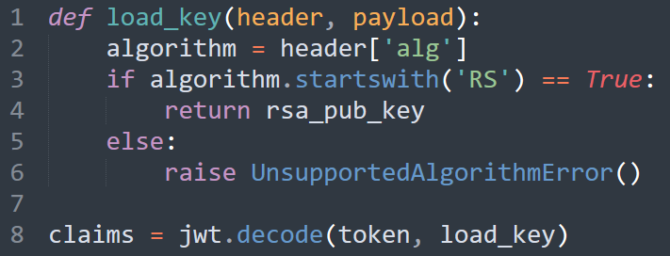
Attack 1: Sign/Encrypt Confusion
Okay, but what if we want to only use digital signatures (RS256, RS384, RS512).
Source: https://docs.authlib.org/en/latest/jose/jwt.html

Slide 29
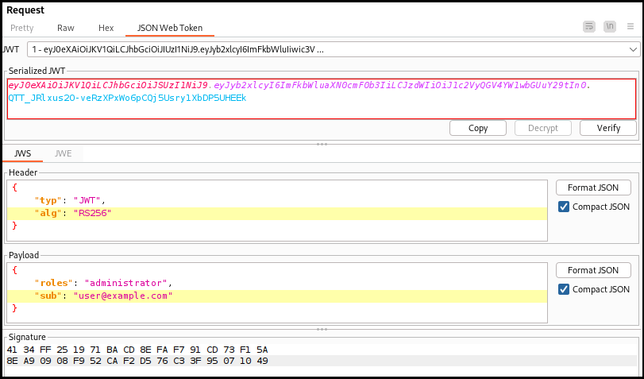
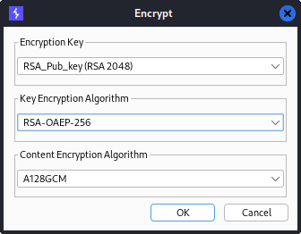
Attack 1: Sign/Encrypt Confusion
Burp Suite (JWT Editor)
Use the public key (compute or OIDC endpoint), to encrypt the JWS -> making it a JWE

Slide 30
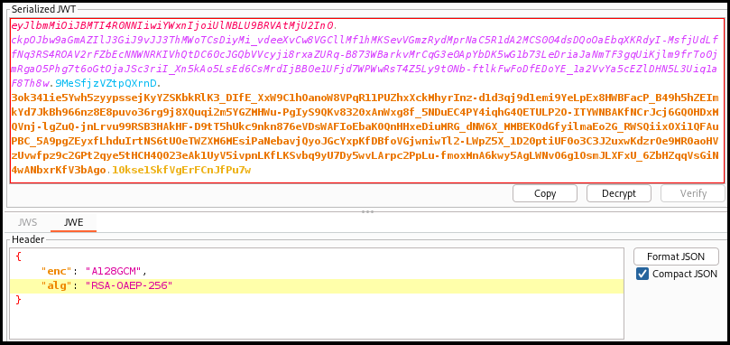
Attack 1: Sign/Encrypt Confusion
Authlib’s jwt.decode parses the alg header, allowing all RS* digital signatures.
Claims validation is handled by JWTClaims.validate().
Accepts RSA-encrypted JWE!

Slide 31
Attack 1: Sign/Encrypt Confusion
Preconditions:
1. Library supports asymmetric JWTs (digital signatures)
2. App uses JWS tokens with RSA or ECDSA (RS*/PS*/ES*)
3. Private key accessible by validation function
4. No specific algorithm or JWT wrapper type is enforced
5. Attacker can determine public key. E.g. by:
- Reading it from OIDC endpoint /.well-known/jwks.json
- If alg is RS* (e.g. RS256), it can be computed from 2 tokens (https://github.com/SecuraBV/jws2pubkey)

Slide 32
Attack 2:
Polyglot Token

Slide 33
JWS Serializations
There are two types of JWS Serializations:
JWS Compact Serialization
JWS JSON Serialization
There are two types of JWS JSON Serialization syntax:
General (or full) JWS JSON Serialization Syntax: Represents the JWS object as a JSON object and uses a fully general syntax. General JSON serialization can contain multiple signatures of the same content and supports JWS protected and unprotected headers.
Flattened JWS JSON Serialization Syntax: Represents the JWS object as a JSON object and uses a flattened syntax. The flattened syntax is based on the general syntax but flattens it to optimize it for the single digital signature or Message Authentication Codes case. The flattened syntax removes the signatures member and places those members that are defined for use in the signatures array in the root-level JSON object.

Slide 34
JWS Compact Serialization
Represents the JWS object as a compact and URL-safe string. Compact serialization can contain only one signature and a JWS protected header. Compact serialization contains no JWS unprotected header. An example (with line breaks for display purposes only):
eyJ0eXAiOiJKV1QiLA0KICJhbGciOiJIUzI1NiJ9
.
eyJpc3MiOiJqb2UiLA0KICJleHAiOjEzMDA4MTkzODAsDQogImh0dHA6Ly9leGFtcGxlLmNvbS9pc19yb290Ijp0cnVlfQ
.
dBjftJeZ4CVP-mB92K27uhbUJU1p1r_wW1gFWFOEjXk

Slide 35
General JWS JSON Serialization Syntax
An example on General JWS JSON Serialization Syntax (with line breaks within values for display purposes only):
{
"payload": "eyJpc3MiOiJqb2UiLA0KICJleHAiOjEzMDA4MTkzODAsDQogImh0dHA6Ly9leGFtcGxlLmNvbS9pc19yb290Ijp0cnVlfQ",
"signatures":[
{
"protected":"eyJhbGciOiJSUzI1NiJ9",
"header": {"kid":"2010-12-29"},
"signature": "cC4hiUPoj9Eetdgtv3hF80EGrhuB__dzERat0XF9g2VtQgr9PJbu3XOiZj5RZmh7AAuHIm4Bh0Qc_lF5YKt_O8W2
Fp5jujGbds9uJdbF9CUAr7t1dnZcAcQjbKBYNX4BAynRFdiuB-f__eSN9383LcOLn6_dO“
},
{
"protected": "eyJhbGciOiJFUzI1NiJ9",
"header": {"kid":"e9bc097a-ce51-4036-9562-d2ade882db0d"},
"signature": "DtEhU3ljbEg8L38VWAfUAqOyKAM6-Xx-F4GawxaepmXFCgfTjDxw5djxLa8ISlSApmWQxfKTUJqPP3-Kg6NU1Q“
}
]
}

Slide 36
Flattened JWS JSON Serialization Syntax
An example on Flattened JWS JSON Serialization Syntax (with line breaks within values for display purposes only):
{
"payload": "eyJpc3MiOiJqb2UiLA0KICJleHAiOjEzMDA4MTkzODAsDQogImh0dHA6Ly9leGFtcGxlLmNvbS9pc19yb290Ijp0cnVlfQ",
"protected":"eyJhbGciOiJFUzI1NiJ9",
"header": {"kid":"e9bc097a-ce51-4036-9562-d2ade882db0d"},
"signature": "DtEhU3ljbEg8L38VWAfUAqOyKAM6-Xx-F4GawxaepmXFCgfTjDxw5djxLa8ISlSApmWQxfKTUJqPP3-Kg6NU1Q"
}

Slide 37
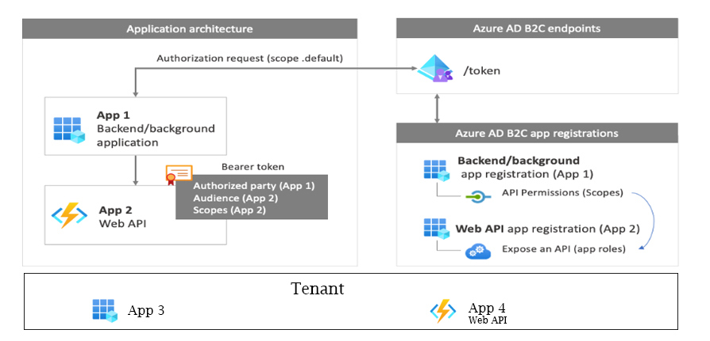
Securely transferring JWTs between applications
How to securely transfer a JWT token from an external application (such as a B2C tenant) to an internal application?
Extra reading material:
https://learn.microsoft.com/en-us/azure/api-management/authentication-authorization-overview
https://learn.microsoft.com/en-us/entra/identity-platform/access-tokens

Slide 38
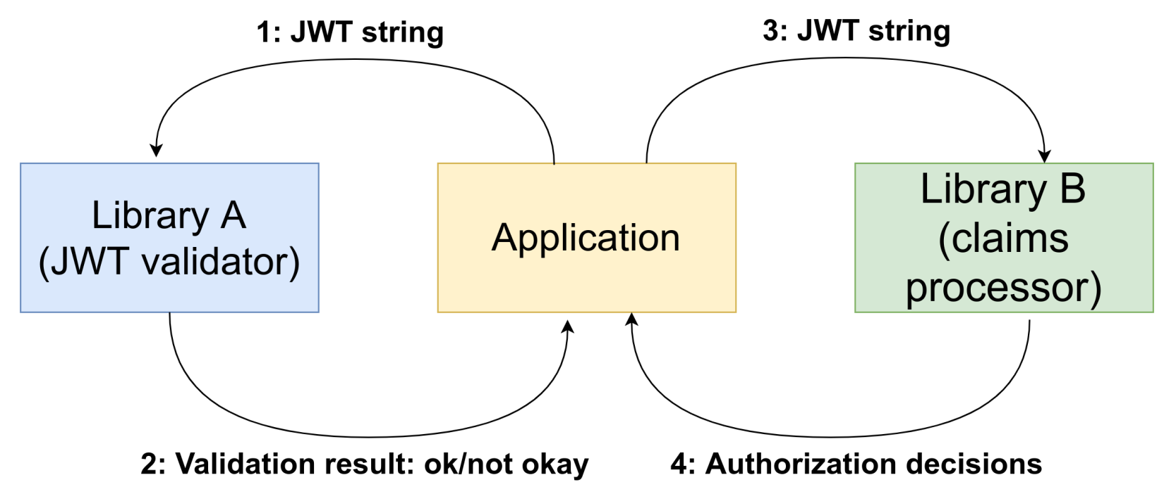
Attack 2: Polyglot Token

Slide 39
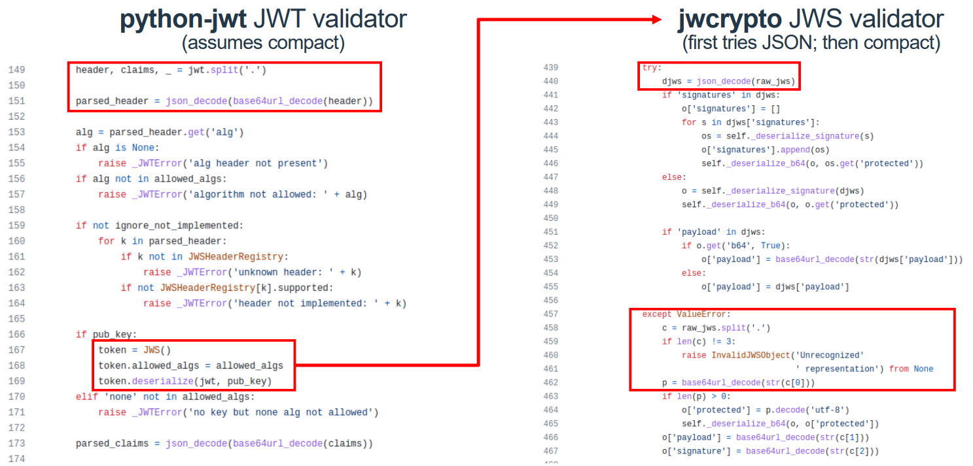
Attack 2: Polyglot Token
jwcrypto does all cryptography (signature etc)
python-jwt will not do any cryptography -> assumes ok and will only validate the claims
The underscore (_) is a versatile symbol. It is commonly used as a throwaway variable.

Slide 40
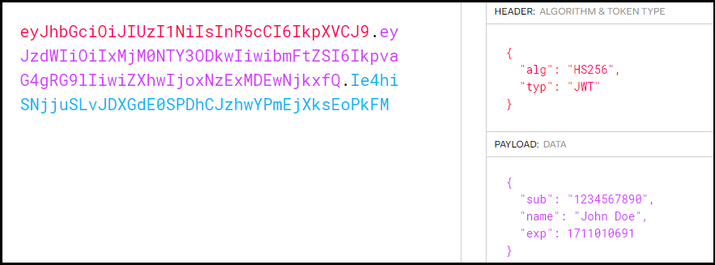
Attack 2: Polyglot Token
Let’s say we have an authentic JWT in a Compact Format.

Slide 41
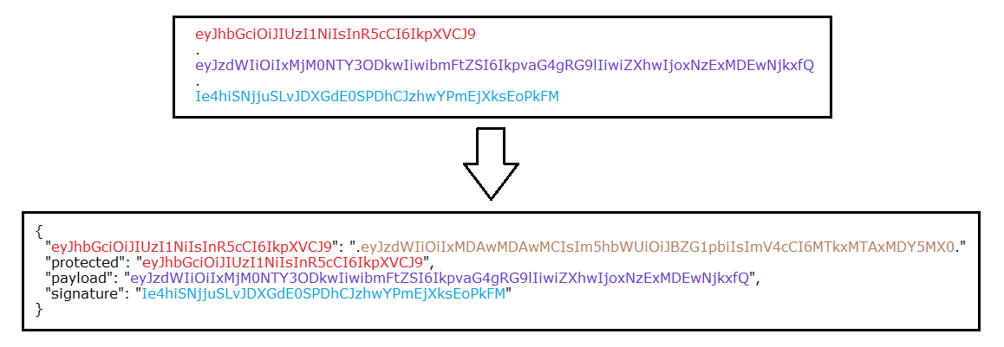
Attack 2: Polyglot Token
And we convert our Compact JWS to Flattened JSON JWS. But, we also add an additional JSON key (the header of the JWS) and a modified payload.
{
"sub": "10000000",
"name": "Admin",
"exp": 1911010691
}

Slide 42
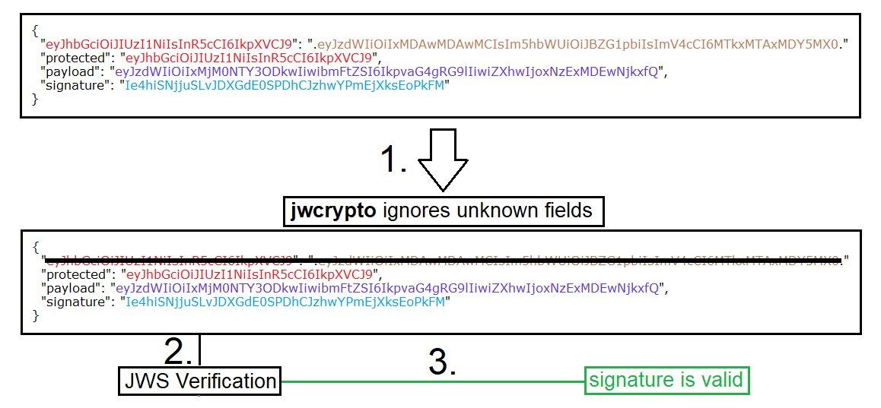
Attack 2: Polyglot Token

Slide 43
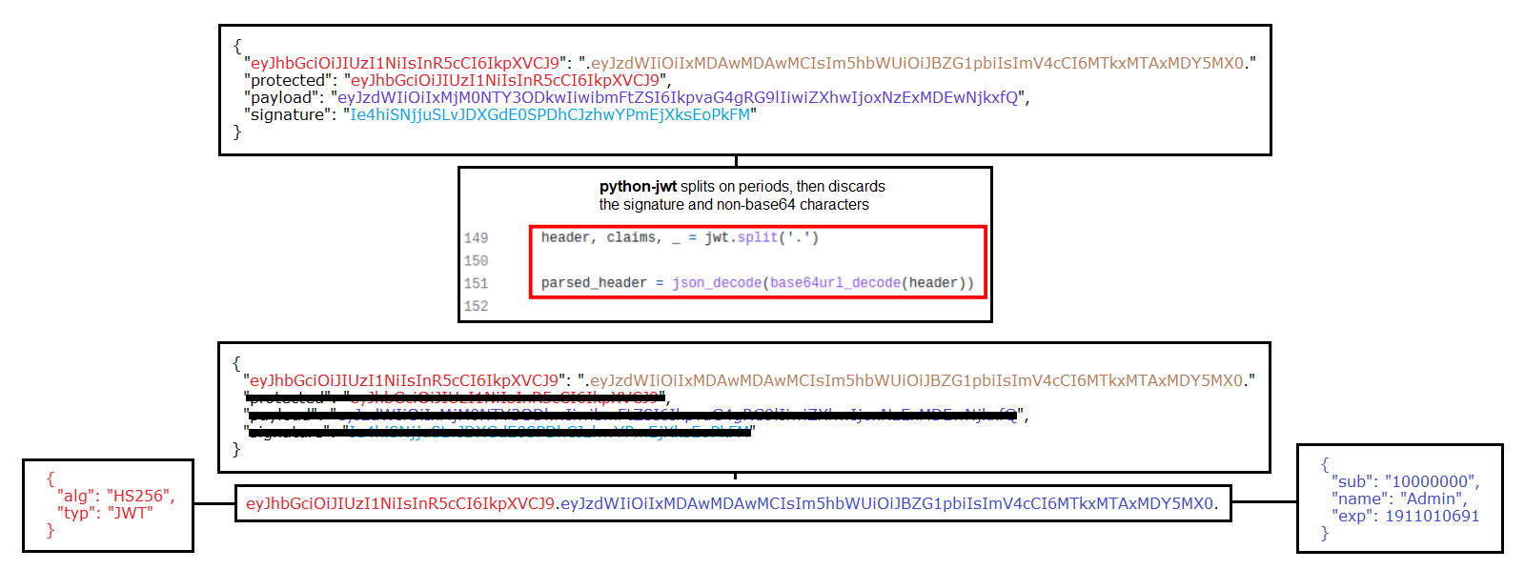
Attack 2: Polyglot Token

Slide 44
Attack 3:
Billion Hashes

Slide 45
Authenticated Encryption Algorithms
In JWEs, the "alg" (Algorithm) Header Parameter identifies the cryptographic algorithm used to encrypt or determine the value of the CEK.
Public / private key encryption | Secret (shared) key encryption | Password based encryption
RSA: • RSA OAEP: • RSA-OAEP • RSA-OAEP-256 • RSA PKCS #1: • RSA1_5 (deprecated) | Direct AES encryption: • dir | PBES2: • PBES2-HS256+A128KW • PBES2-HS384+A192KW • PBES2-HS512+A256KW
EC (Elliptic Curve): • ECDH-ES with EC or OKP key: • ECDH-ES • ECDH-ES+A128KW • ECDH-ES+A192KW • ECDH-ES+A256KW | AES key wrap: • A128KW • A192KW • A256KW
 | AES GCM key encryption: • A128GCMKW • A192GCMKW • A256GCMKW

Slide 46
Key Encryption with PBES2
1. Derive a key from a user-supplied password using PBES2 schemes
2. Perform encryption of a JWE CEK
In a password-based key derivation function, the base key is a password and the other parameters are a salt value and an iteration count (combine a password with a salt to produce a key).
Two functions are specified: PBKDF1 and PBKDF2.
PBKDF2 is recommended for new applications; PBKDF1 is included only for compatibility with existing applications, and is not recommended for new applications.

Slide 47
Key Encryption (in JWE) with PBES2
PBKDF2 applies a pseudorandom function to derive keys. PBKDF2 (P, S, c, dkLen)
Options: PRF underlying pseudorandom function (hLen
denotes the length in octets of the
pseudorandom function output)
Input: P password (an octet string)
S salt (an octet string)
c iteration count (a positive integer)
dkLen intended length in octets of the derived key,
a positive integer, at most (2^32 - 1) * hLen
Output: DK derived key, a dkLen-octet string
https://datatracker.ietf.org/doc/html/rfc2898#section-5.2

Slide 48
PBES2 Encryption Operation
The encryption operation for PBES2 consists of the following steps, which encrypt a message M under a password P to produce a ciphertext C, applying a selected key derivation function KDF and a selected underlying encryption scheme:
1. Select a salt S and an iteration count c
2. Select the length in octets, dkLen, for the derived key for the underlying encryption scheme.
3. Apply the selected key derivation function (PBKDF2) to the password P, the salt S, and the iteration count c to produce a derived key
DK = KDF (P, S, c, dkLen) .
4. Encrypt the message M with the underlying encryption scheme under the derived key DK to produce a ciphertext C. (This step may involve selection of parameters such as an initialization vector and padding, depending on the underlying scheme.)
5. Output the ciphertext C.

Slide 49
PBES2 Decryption Operation
The decryption operation for PBES2 consists of the following steps, which decrypt a ciphertext C under a password P to recover a message M:
1. Obtain the salt S for the operation.
2. Obtain the iteration count c for the key derivation function.
3. Obtain the key length in octets, dkLen, for the derived key for the underlying encryption scheme.
4. Apply the selected key derivation function to the password P, the salt S, and the iteration count c to produce a derived key DK of length dkLen octets:
DK = KDF (P, S, c, dkLen) .
5. Decrypt the ciphertext C with the underlying encryption scheme under the derived key DK to recover a message M. If the decryption function outputs "decryption error," then output "decryption error" and stop.
6. Output the recovered message M.

Slide 50
Header Parameters Used for PBES2 Key Encryption
“enc" Param Value | Content Encryption Algorithm | Implementation Requirements
A128CBC-HS256 | AES_128_CBC_HMAC_SHA_256 authenticated encryption algorithm | Required
A192CBC-HS384 | AES_192_CBC_HMAC_SHA_384 authenticated encryption algorithm | Optional
A256CBC-HS512 | AES_256_CBC_HMAC_SHA_512 authenticated encryption algorithm | Required
A128GCM | AES GCM using 128-bit key | Recommended
A192GCM | AES GCM using 192-bit key | Optional
A256GCM | AES GCM using 256-bit key | Recommended

Slide 51
Header Parameters Used for PBES2 Key Encryption
"alg" Param Value | Key Management Algorithm
PBES2-HS256+A128KW | PBES2 with HMAC SHA-256 and "A128KW“ wrapping
PBES2-HS384+A192KW | PBES2 with HMAC SHA-384 and "A192KW“ wrapping
PBES2-HS512+A256KW | PBES2 with HMAC SHA-512 and "A256KW“ wrapping
Additional Header Parameters | Value
"p2s" (PBES2 Salt Input) | A Salt Input value containing 8 or more octets MUST be used -> BASE64URL(Salt Input)
"p2c" (PBES2 Count) | PBKDF2 iteration count, represented as a positive JSON integer. A minimum iteration count of 1000 is RECOMMENDED

Slide 52
Attack 3: Billion Hashes Attack
{
"alg": "PBES2-HS512+A256KW",
"p2s": "AAAAAAAAAAAAAAAAAAAAAA",
"p2c": 2147483647,
"enc": "A128CBC-HS256"
}
• Rest of the JWE can consist of bogus strings.
• The server needs to compute billion hashes to derive the content encryption key before it can determine that this JWT is invalid.
• Unauthenticated: attacker does not need to know what a valid token looks like.
• It has to do this for every request with a JWT!

Slide 53
Impacted JWT libraries
Library | Language | Affected Versions | Vulnerability | CVE
Authlib | Python | < v1.1.0 | Sign/encrypt confusion | CVE-2022-39174
JWCrypto | Python | < v1.4 | Sign/encrypt confusion | CVE-2022-3102
JWX | PHP | < 0.12.0 | Sign/encrypt confusion
Python-jwt | Python | < v3.3.4 | Polyglot token | CVE-2022-39227
Jose | JavaScript | < v1.28.1, v2.0.5, v3.20.3, v4.9.1 | Billion hashes | CVE-2022-36083
Jose-jwt | .NET | < v4.1 | Billion hashes

Slide 54
Resources
Password-Based Cryptography Specification - https://datatracker.ietf.org/doc/html/rfc2898
JSON Web Signature (JWS) RFC 7515 - https://datatracker.ietf.org/doc/html/rfc7515
JSON Web Encryption (JWE) RFC 7516 - https://datatracker.ietf.org/doc/html/rfc7516
JSON Web Key (JWK) RFC 7517 - https://datatracker.ietf.org/doc/html/rfc7517
JSON Web Algorithms (JWA) RFC 7518 - https://datatracker.ietf.org/doc/html/rfc7518
JSON Web Token (JWT) RFC 7519 - https://datatracker.ietf.org/doc/html/rfc7519
Examples of Protecting Content Using JSON Object Signing and Encryption (JOSE) - https://www.rfc-editor.org/rfc/rfc7520.html
Use Cases and Requirements for JSON Object Signing and Encryption (JOSE) - https://www.rfc-editor.org/rfc/rfc7165.html
Authlib JOSE Guide - https://docs.authlib.org/en/latest/jose/index.html
Original Research by Tom Tervoort - https://www.blackhat.com/us-23/briefings/schedule/#three-new-attacks-against-json-web-tokens-31695

Slide 55
Resources
How to select a JOSE / JWT cryptographic algorithm for your application - https://connect2id.com/products/nimbus-jose-jwt/algorithm-selection-guide
JSON Web Token Claims - https://www.iana.org/assignments/jwt/jwt.xhtml#claims
JSON Web Token (JWT) Signing Algorithms Overview - https://auth0.com/blog/json-web-token-signing-algorithms-overview/
JWT Claims - https://stytch.com/blog/jwt-claims/
JWT authentication - https://www.ibm.com/docs/en/order-management?topic=users-jwt-authentication
JWT Handbook - https://auth0.com/resources/ebooks/jwt-handbook/thankyou
Javascript Object Signing and Encryption (JOSE) - https://jose.readthedocs.io/en/latest/
Authentication and authorization to APIs in Azure API Management - https://learn.microsoft.com/en-us/azure/api-management/authentication-authorization-overview

Slide 56


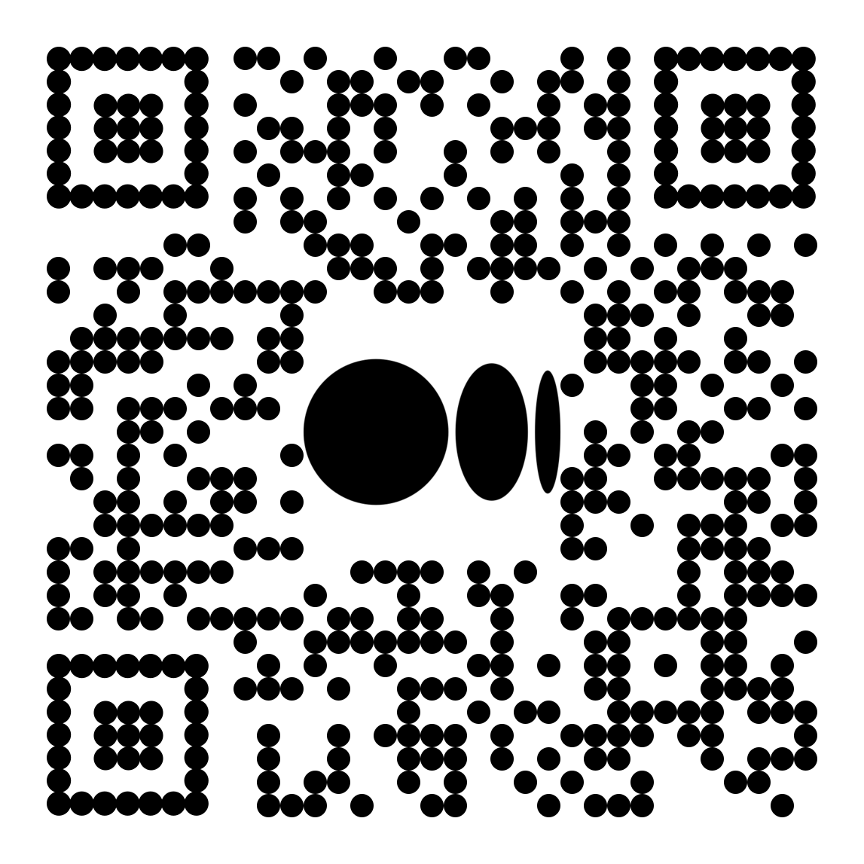
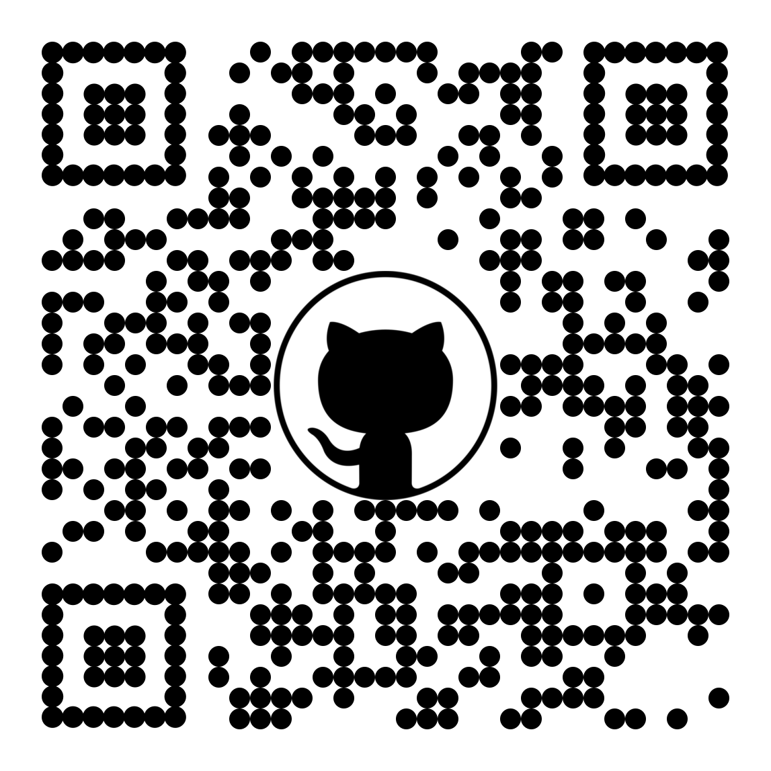
Questions?
SoCyber
LinkedIn
Medium
GitHub

